Slide 1
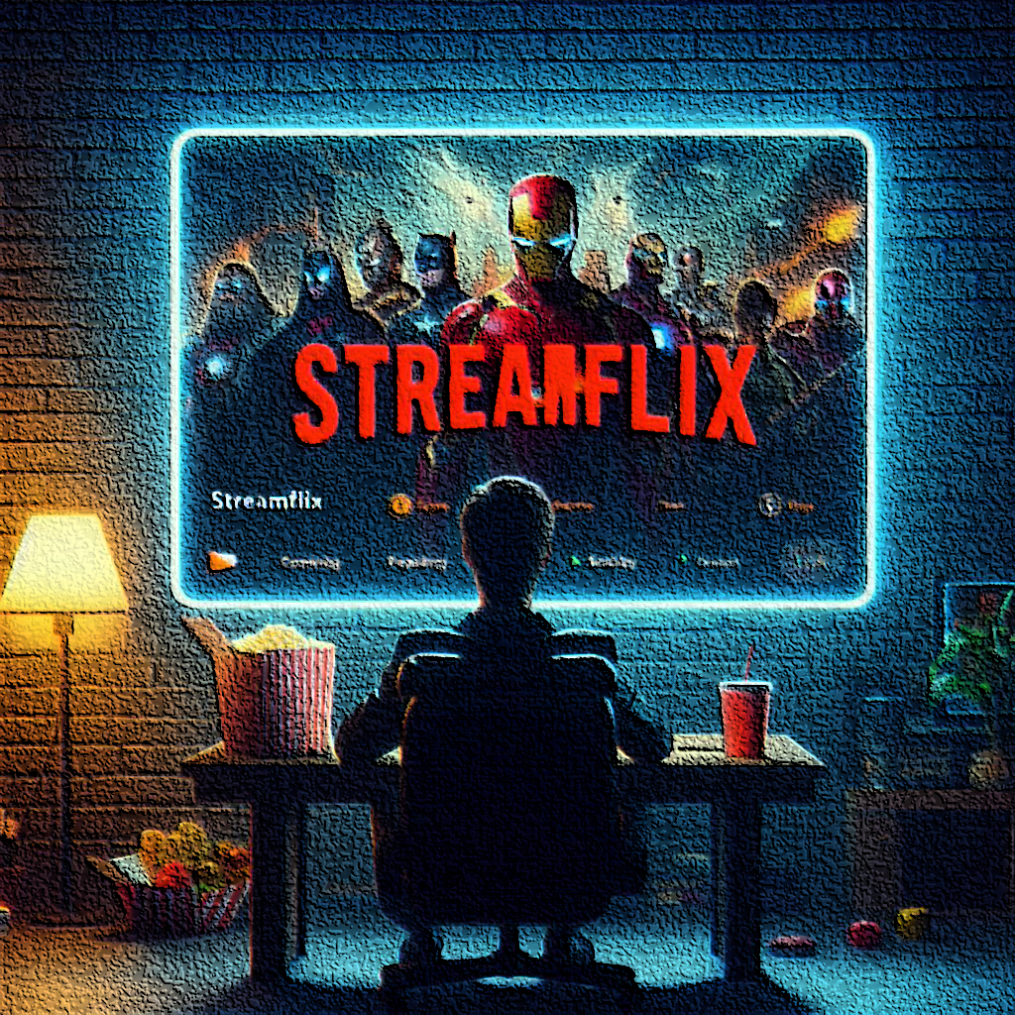
STREAMFLIX MOVIE RECOMMENDATION SYSTEM
Created by
Evaclaire Munyika
Simon Makumi

Slide 2
Table of Contents
01
02
03
04
05
06
Business Understanding
Data Understanding
Observations and Results
Conclusion
Recommendations
Next steps

Slide 3

"Creativity is the key to unlocking your true potential"

Slide 4
BUSINESS UNDERSTANDING

Slide 5
Overview
Streamflix aims to enhance user experience by implementing a hybrid movie recommendation system that combines collaborative filtering and content-based techniques to offer personalized top 5 movie suggestions.
Business Problem
Streamflix is grappling with user retention and engagement issues as users frequently experience frustration with content selection. These challenges are adversely affecting Streamflix's revenue, customer satisfaction and competitive position in the streaming industry.
Objective
To develop and deploy a hybrid recommendation system that combines collaborative filtering and content-based filtering techniques to enhance recommendation accuracy by capturing both user-item interactions and movie attributes ensuring a more personalized movie recommendation experience.

Slide 6
DATA UNDERSTANDING

Slide 7
Data Source
Our data is from the MovieLens dataset by the GroupLens research lab at the University of Minnesota.
Main Features Used
Movie_id: Unique identifier for each movie.
Title: Movie title.
Genres: Movie genres.
User_id: Unique Identifier for users .
Rating: Rating given by the user.

Slide 8
OBSERVATIONS

Slide 9
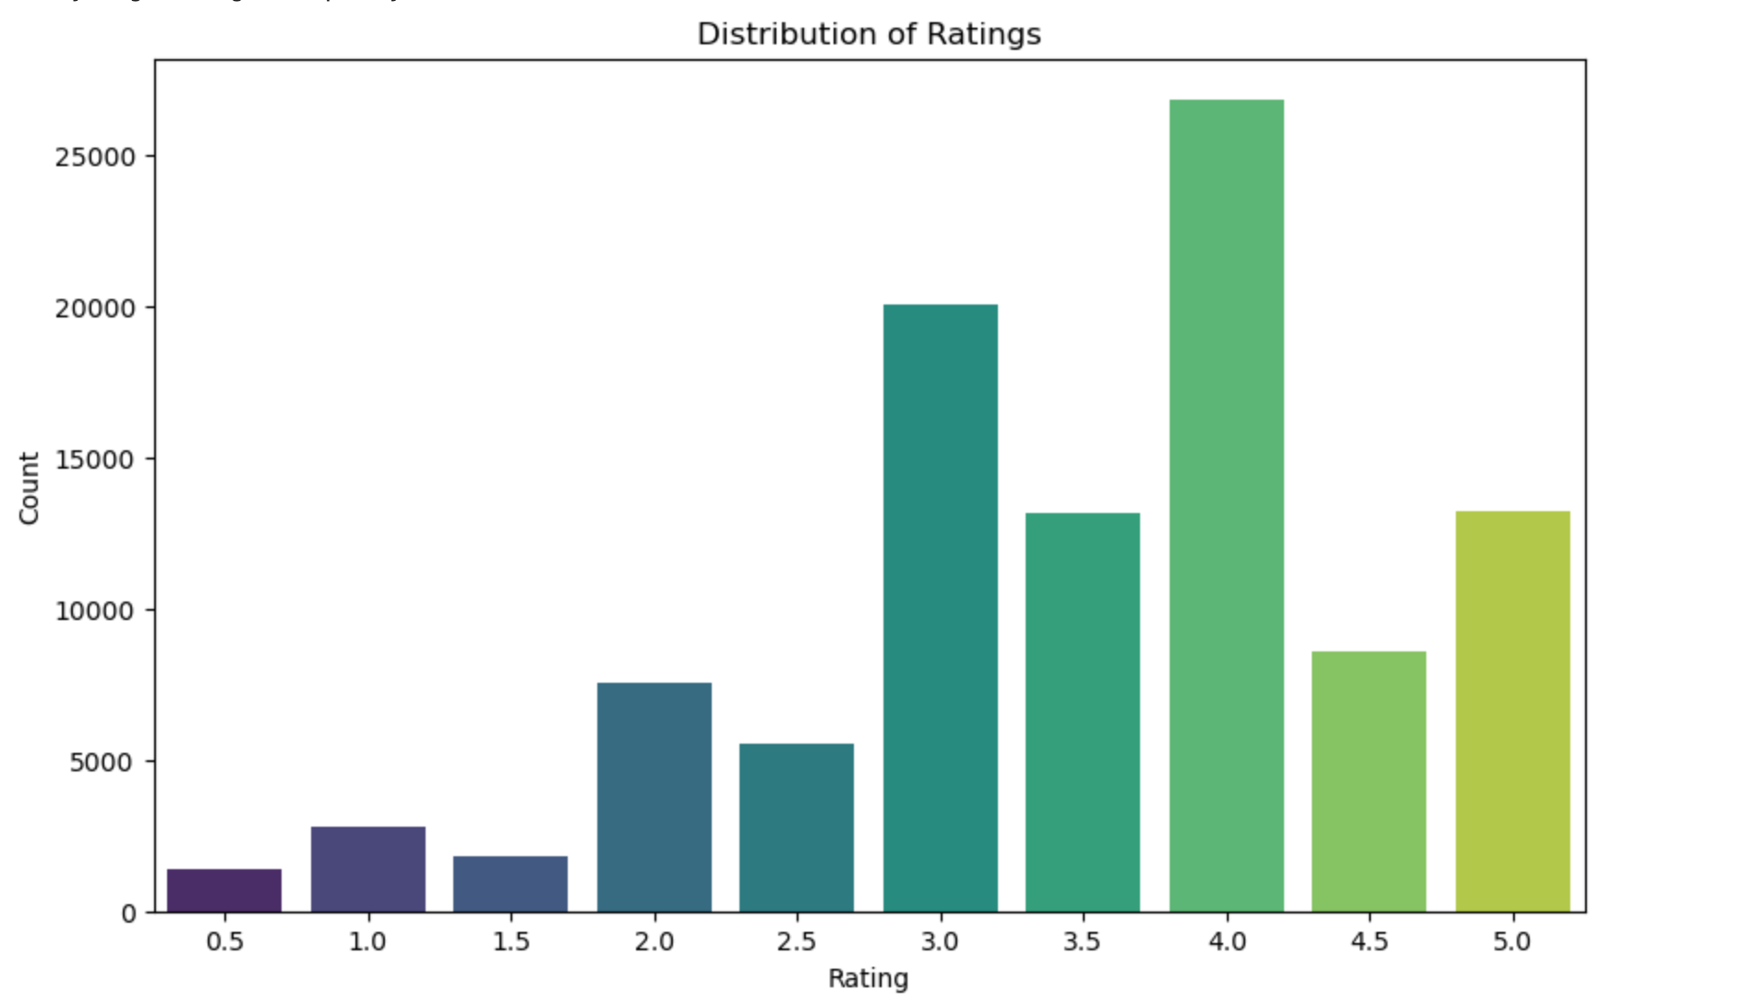

Slide 10
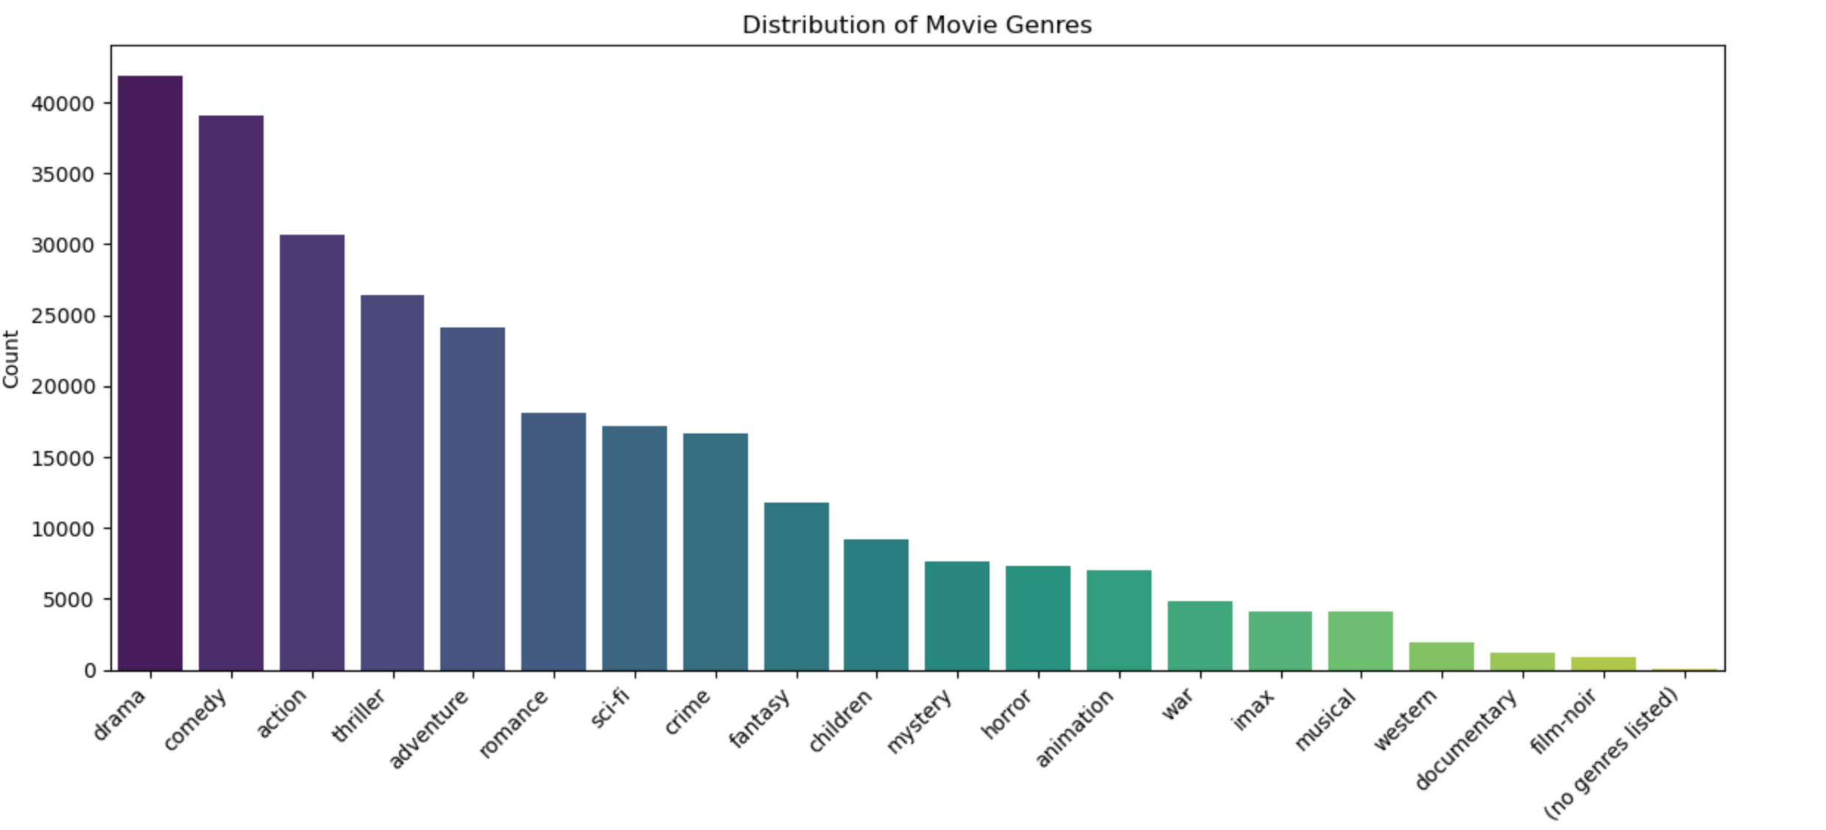

Slide 11
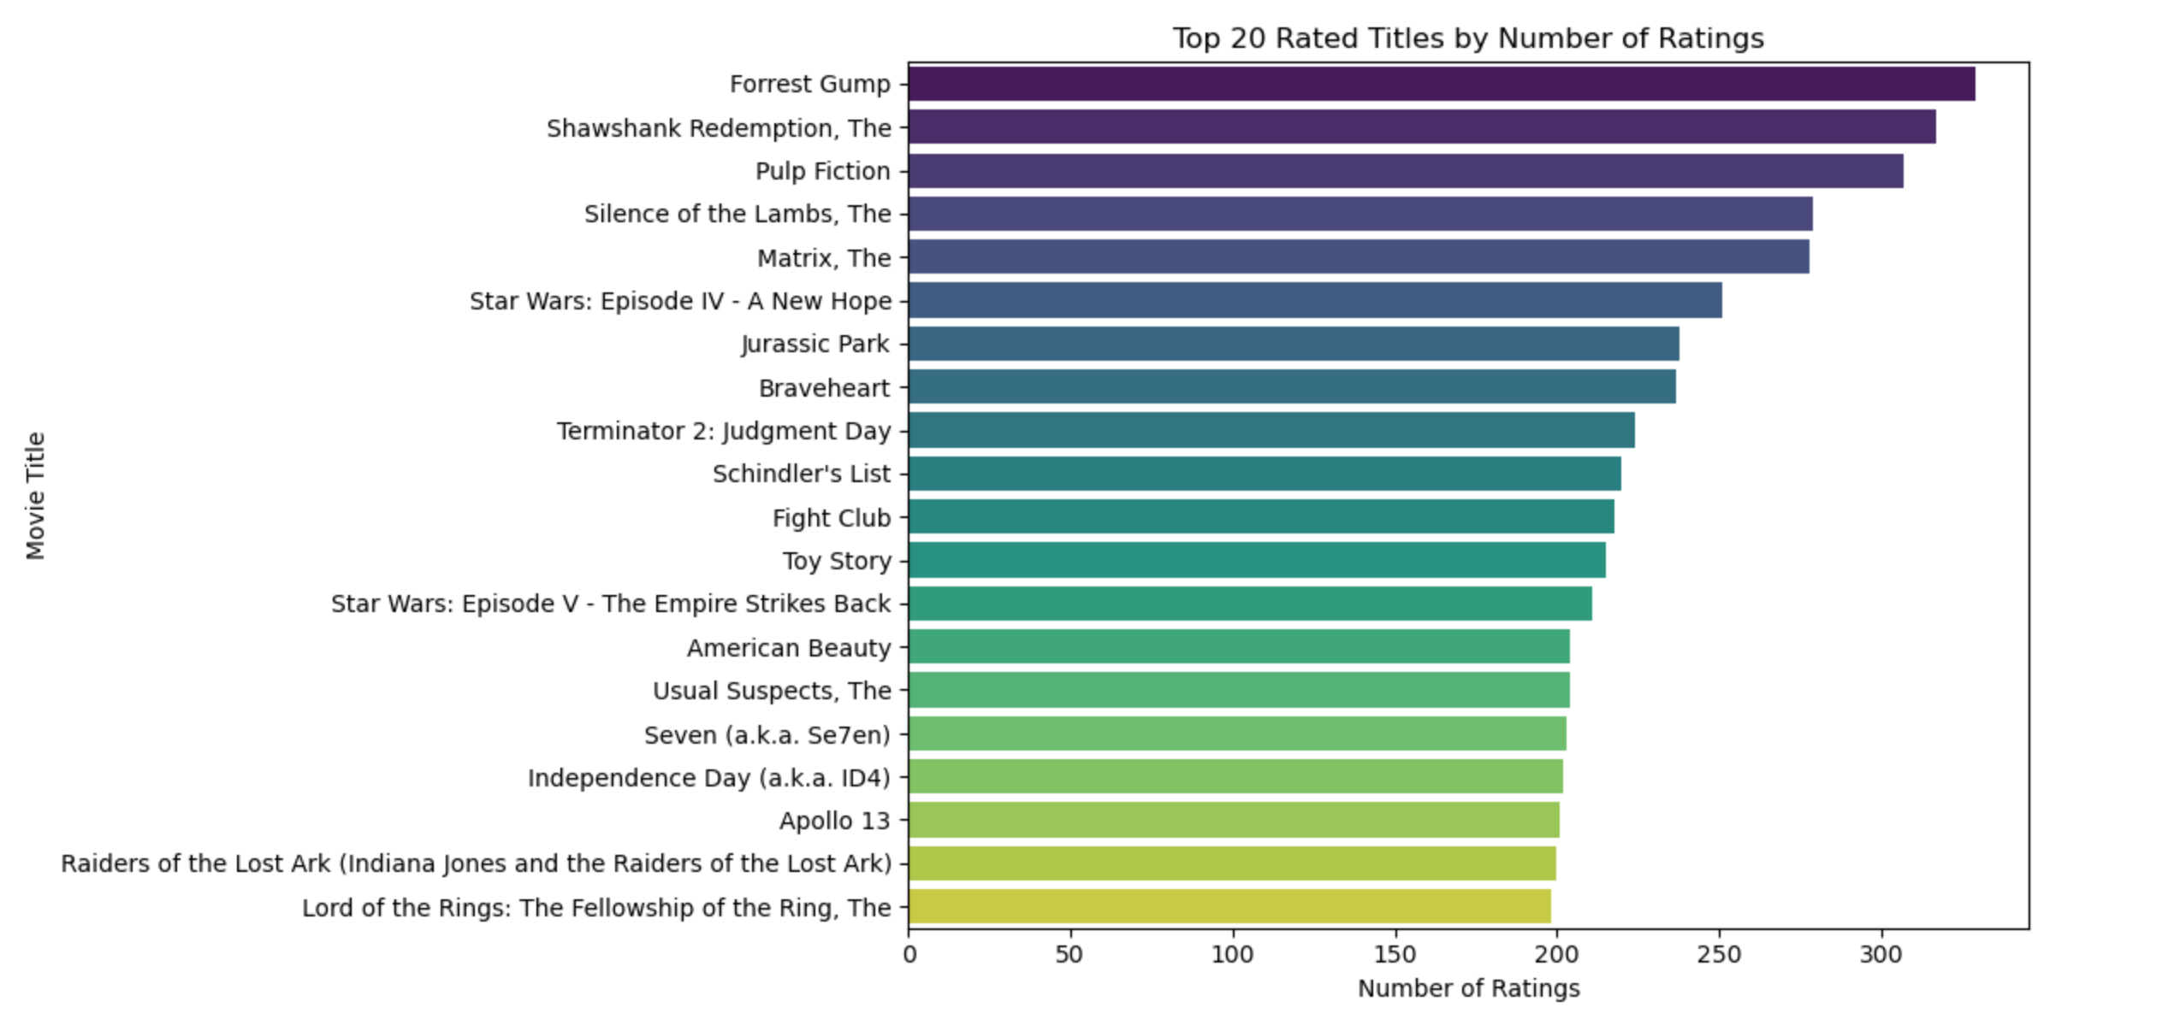

Slide 12
MODELING RESULTS

Slide 13
Previous projects
Best performing model
Evaluation metrics

Slide 14
CONCLUSIONS

Slide 16
RECOMMENDATIONS

Slide 18
NEXT STEPS

Slide 20
Thank You!
For any follow up questions,
reach out to me on:
evamunyika@gmail.com

